Slide 1
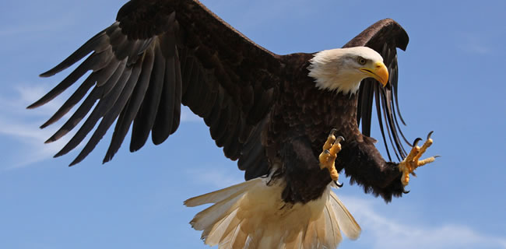
Eagle Tracker
Crowd supported Eagle tracking made simple.
Team 5

Slide 2
Application Description
What we wanted it to do
What we accomplished
What we still need to do?
Other integrations or features?

Slide 3
Diagrams
Use Case
State
Activity
findEagle Sequence Diagram
reportEagle Sequence Diagram
Class Plan
Class Simple

Slide 4
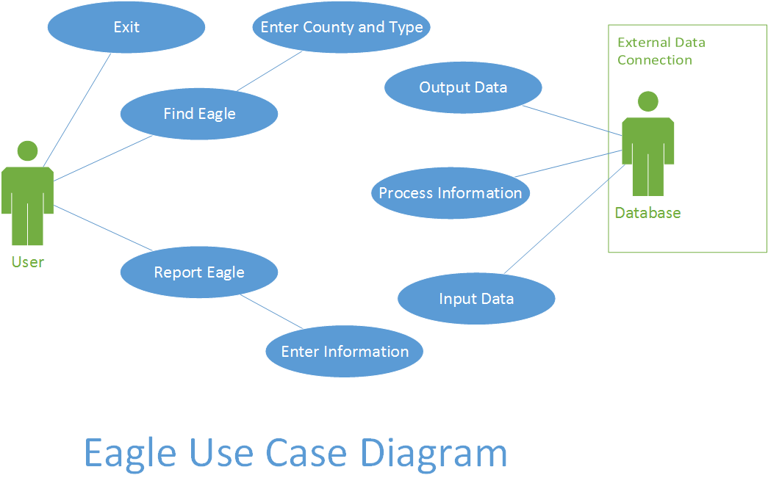
Diagrams - Use Case Diagram

Slide 5
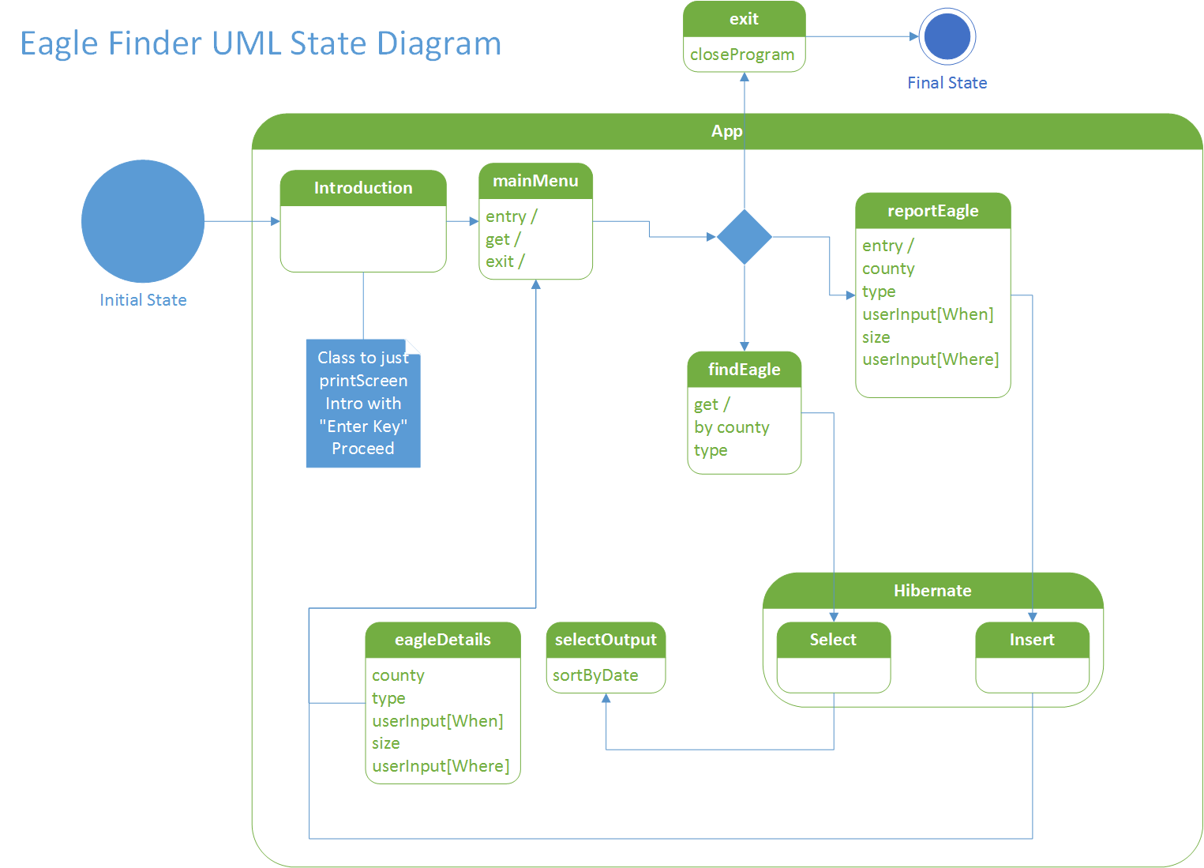
Diagrams - State Diagram

Slide 6
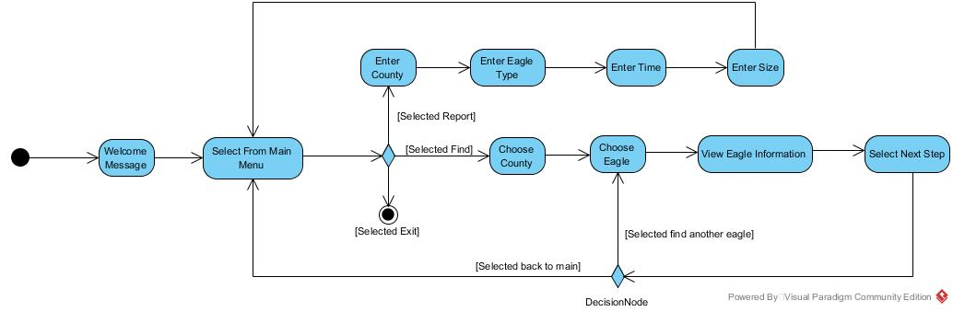
Diagrams - Activity Diagram

Slide 7
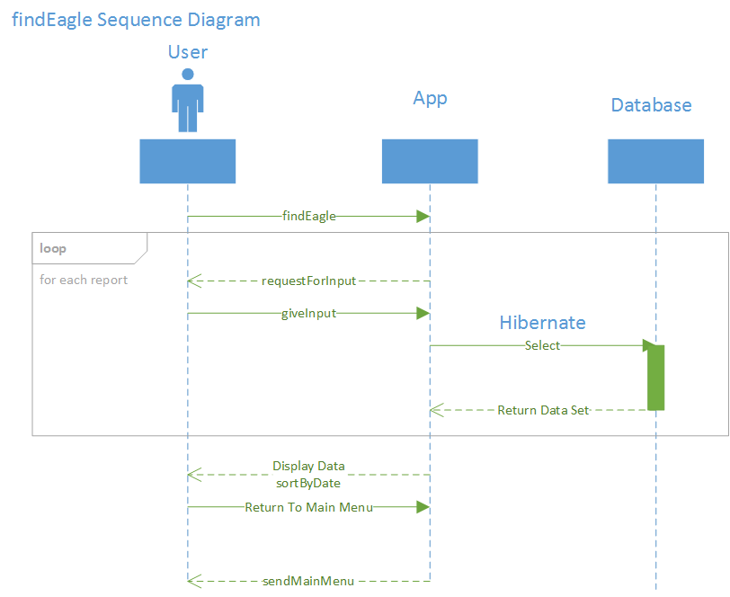
Diagrams - findEagle Sequence Diagram

Slide 8
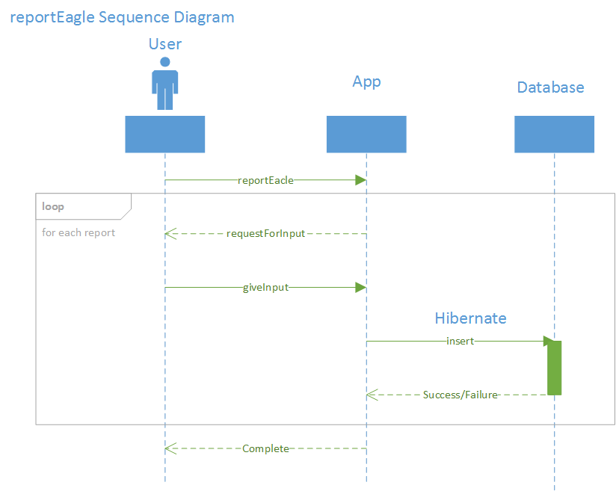
Diagrams - reportEagle Sequence Diagram

Slide 9
Diagrams - reportEagle Sequence Diagram

Slide 10
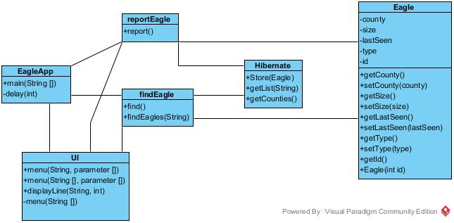
Diagrams – Class Plan

Slide 11
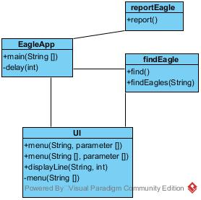
Diagrams – Class Simple

Slide 12
Methodology
Agile - How we implemented it
Adjusted “Stand up” Meetings
Roles
Backlog

Slide 13
Schedule?
How did we do?
Challenges?
Successes?

Slide 14
App Demo
Show what we have and go over code

